Slide 1
Inverse Semigroups
Adam Gaffney

Slide 2
Overview
When and why? – A brief history
Basic definitions – Group /Semigroup theory
Inverse semigroups – Some definitions and properties
Symmetric inverse monoid
Wagner-Preston representation theorem
A useful example
What’s next?

Slide 3
Semigroup History
Three names in beginning of semigroup theory
Anton Suschkewitsch
First real “semigroup theorist”
Active in the 1910’s
Alfred Clifford
Published a significant paper in 1940
David Rees
Considered to have popularized semigroup theory along with Clifford

Slide 4
Inverse Semigroup History
Two major names at the beginning of inverse semigroup theory
Victor Wagner
Published a paper on “generalized groups” in 1952
Gordon Preston
Coined the term “inverse semigroups”
Published his paper on inverse semigroups in 1954
Politics of the Cold War lead to lack of communication – Iron Curtain
Wagner and Preston made these discoveries independently

Slide 5

Groups
$$Let G be a non empty set with ∙as the binary operation. Then \left(G, ∙\right) is a group if it is \\ Closed:For a,b∈G, a∙b∈G \\ Associative:For a,b,c∈G, \left(a∙b\right)∙c=a∙\left(b∙c\right) \\ Identity:There exists an element e∈G such that a∙e=e∙a=a for a∈G \\ Inverse:Every element a∈G has an inverse a^{−1}∈G such that a∙a^{−1}=a^{−1}∙a=e$$
Examples of groups
The real numbers with addition
The integers with addition
Non-zero rational numbers with multiplication

Slide 6
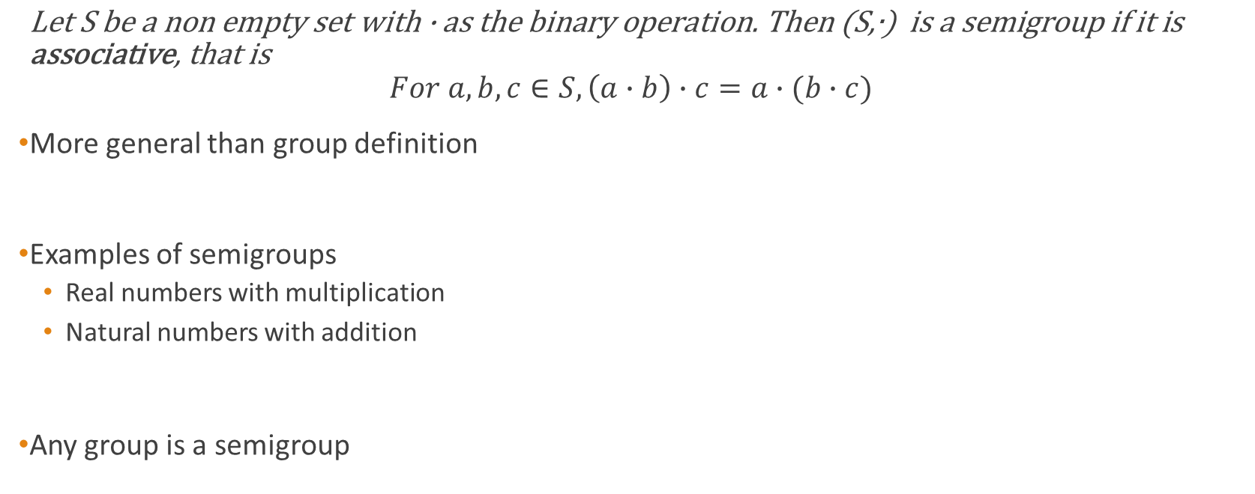
Semigroups
$\text{Let} \text{S} \text{be} \text{a} \text{non} \text{empty} \text{set} \text{with} \text{∙} \text{as} \text{the} \text{binary} \text{operation}\text{. }\text{Then}\text{ (}\text{S}\text{,∙) }\text{is} \text{a} \text{semigroup} \text{if} \text{it} \text{is} \text{associative}\text{, }\text{that} \text{is}$ $For a,b,c∈S, \left(a∙b\right)∙c=a∙(b∙c)$
More general than group definition
Examples of semigroups
Real numbers with multiplication
Natural numbers with addition
Any group is a semigroup

Slide 7
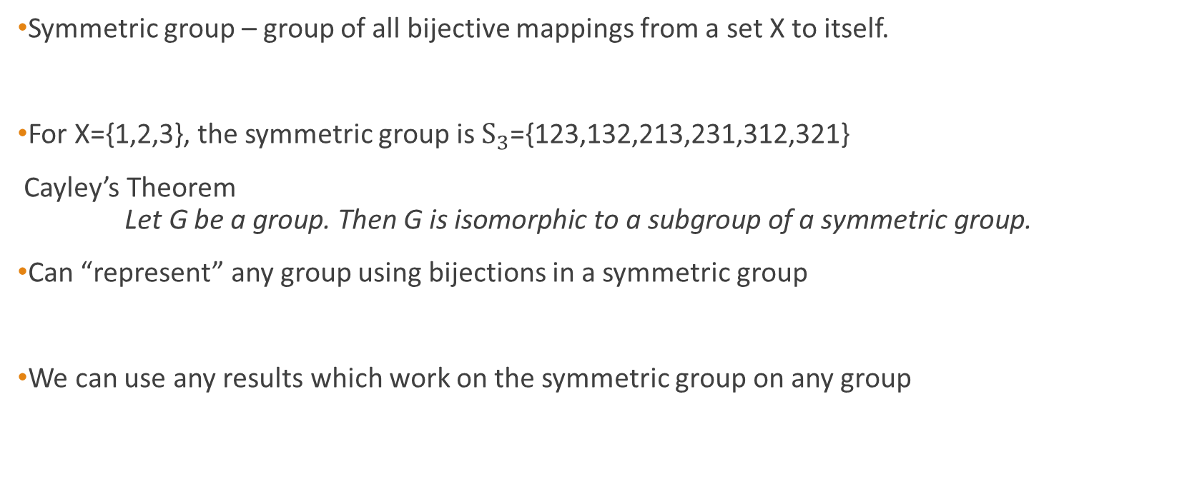
Cayley’s Theorem
Symmetric group – group of all bijective mappings from a set X to itself.
For X={1,2,3}, the symmetric group is $S_{3}$={123,132,213,231,312,321}
Cayley’s Theorem $\text{Let} \text{G} \text{be} \text{a} \text{group}\text{. }\text{Then} \text{G} \text{is} \text{isomorphic} \text{to} \text{a} \text{subgroup} \text{of} \text{a} \text{symmetric} \text{group}\text{.}$
Can “represent” any group using bijections in a symmetric group
We can use any results which work on the symmetric group on any group

Slide 8
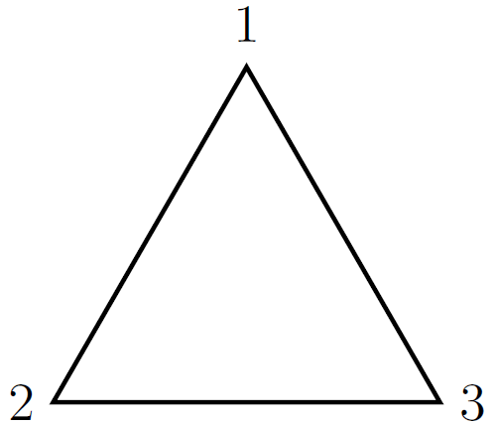
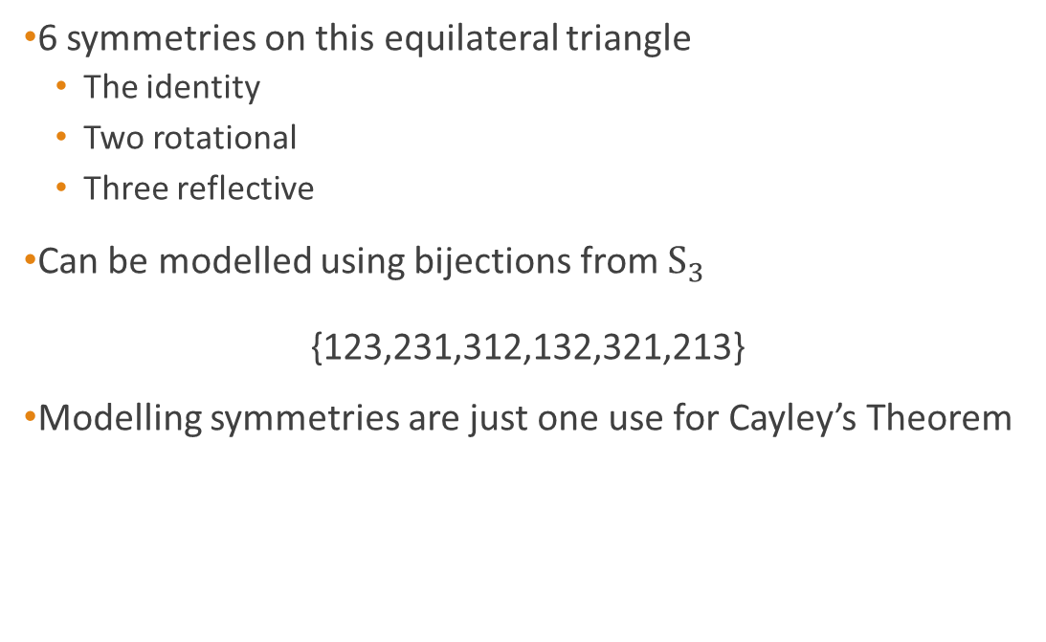
Example
6 symmetries on this equilateral triangle
The identity
Two rotational
Three reflective
Can be modelled using bijections from $S_{3}$ {123,231,312,132,321,213}
Modelling symmetries are just one use for Cayley’s Theorem

Slide 9
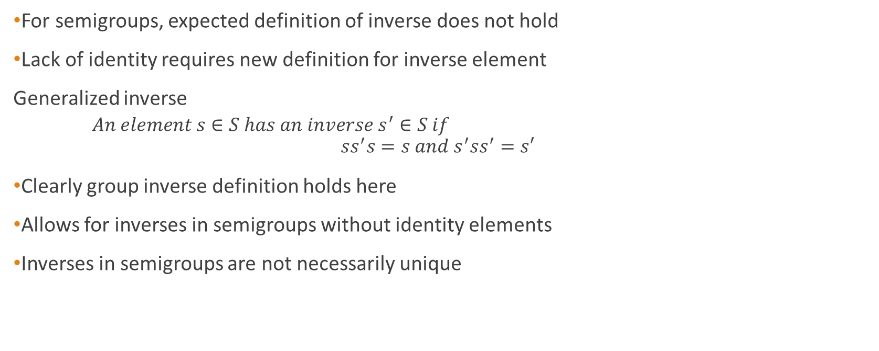
Inverses
For semigroups, expected definition of inverse does not hold
Lack of identity requires new definition for inverse element
Generalized inverse
$An element s∈S has an inverse s^{′}∈S if$ $${ss}^{′}s=s and s^{′}{ss}^{′}=s′$$
Clearly group inverse definition holds here
Allows for inverses in semigroups without identity elements
Inverses in semigroups are not necessarily unique

Slide 10
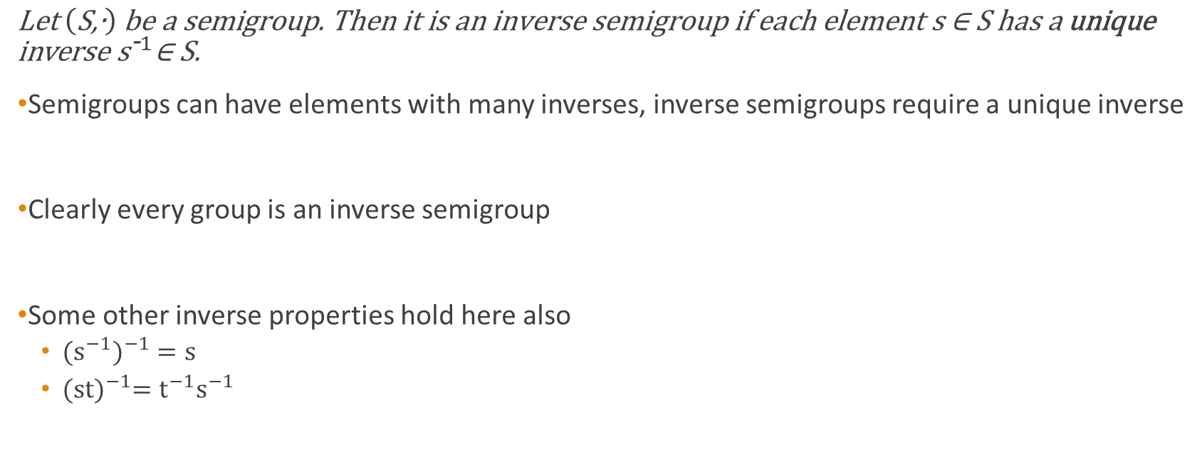
Inverse Semigroups
$$\text{Let} \left(\text{S}\text{,∙}\right) \text{be} \text{a} \text{semigroup}\text{. }\text{Then} \text{it} \text{is} \text{an} \text{inverse} \text{semigroup} \text{if} \text{each} \text{element} \text{s}\text{ ∈ }\text{S} \text{has} \text{a} \text{unique} \text{inverse} {\text{s}}^{\text{-}1}\text{∈ }\text{S}\text{.}$$
Semigroups can have elements with many inverses, inverse semigroups require a unique inverse
Clearly every group is an inverse semigroup
Some other inverse properties hold here also
${{(s}^{−1})}^{−1}=s$
${(st)}^{−1}=t^{−1}s^{−1}$

Slide 11
Symmetric Inverse Monoid
Symmetric Inverse Monoid Inverse semigroup comprising of partial bijective mappings which map from subsets of a set X to other subsets of X
The inverse semigroup equivalent of the symmetric group
Monoid as the identity mapping is a bijective mapping
Partial bijection – Only a subset of the set X forms the domain for the bijection
Domain and image are subsets of the set X, unlike the symmetric group

Slide 12
Wagner-Preston Representation Theorem
Wagner-Preston Representation Theorem Any inverse semigroup S can be embedded into a symmetric inverse monoid
Named after the two inverse semigroup theorists that discovered it
Analogous to Cayley’s Theorem
Uses partial bijections as well as bijections from the symmetric group
Can show extra detail group theory could not capture

Slide 13
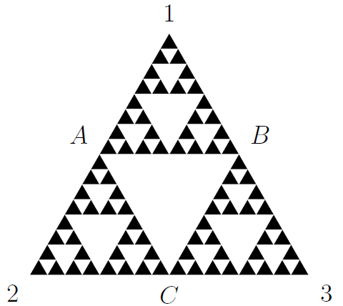
Example
Fractal shape continues ad infinitum
Using the symmetric group gives equivalent symmetries to the equilateral triangle
Partial symmetries lost without partial bijections
The triangle 123 forms a partial symmetry with the triangle A2C
Can be applied on any level of the fractal

Slide 14
What’s Next?
Many directions that can be studied from here
Partial order
A way of ordering sets from smallest magnitude to largest.
Green’s relations
Describe the “large scale structure” of semigroups
Use a concept called an “ideal” to relate elements of an entire semigroup
Incredibly important topic in semigroup theory
Free semigroups
Free monoid is a set of finite sequences, with operation of concatenation
A semigroup is “free” if it is isomorphic to this free monoid

Slide 15
Thank you for listening
Any questions?

